Slide 1

EEI4346 Web Technology Day School 04
H.R.S.Senanayake
Email: hrsen@ou.ac.lk CITES Faculty of Engineering Technology The Open University of Sri Lanka

Slide 2

Content
Web Services
Enterprise Integration
Interacting with Database
Department of……………………………

Slide 3
Web Services
Department of……………………………

Slide 4
What is Web Service
A Web Service is can be defined in the following ways:
It is a client-server application or application component for communication.
The method of communication between two devices over the network.
It is a software system for interoperable machine-to-machine communication.
It is a collection of standards or protocols for exchanging information between two devices or application
Department of……………………………

Slide 5
Web Service Features
XML-Based/ JSON Bases
Web services use XML/JSON at data description and data transportation layers.
Using XML/JSON excludes any networking, operating system, or platform binding.
Web services-based operation is extremely interoperable at its core level.
Loosely Coupled
A tightly coupled system means that the client and server logic are closely tied to one another, indicating that if one interface changes, then another must be updated.
Accepting a loosely coupled architecture tends to make software systems more manageable and allows more straightforward integration between various systems.
Department of……………………………

Slide 6
Web Service Features
Coarse-Grained
Businesses and the interfaces that they prove should be coarse-grained.
Web services technology implement a natural method of defining coarse-grained services that approach the right amount of business logic.
i.e.: Separate the business functions to Crud operations or any other business Purpose
Example : CreateCustomer, DeleteCustomer, EditCustomer, SerachCustomer, etc
Ability to be Synchronous or Asynchronous
In synchronous invocations, the client blocks and delays in completing its service before continuing.
Asynchronous operations grant a client to invoke a task and then execute other functions.
Asynchronous clients fetch their results at a later point in time, while synchronous clients receive their effect when the service has been completed.
Asynchronous capability is an essential method in enabling loosely coupled systems.
Department of……………………………

Slide 7
Web Service Components
There are three major web service components.
SOAP
WSDL
UDDI
Department of……………………………

Slide 8
SOAP
SOAP is an acronym for Simple Object Access Protocol.
SOAP is an XML-based protocol for accessing web services.
SOAP is a W3C recommendation for communication between applications.
SOAP is XML-based, so it is platform-independent and language-independent. In other words, it can be used with Java, .NET, or PHP language on any platform.
Department of……………………………

Slide 9
WSDL
WSDL stands for Web Services Description Language
WSDL is used to describe web services
WSDL is written in XML
WSDL is an integral part of Universal Description, Discovery, and Integration (UDDI), an XML-based worldwide business registry
Department of……………………………

Slide 10
UDDI
UDDI is an acronym for Universal Description, Discovery, and Integration.
UDDI is an XML-based framework for describing, discovering, and integrating web services.
UDDI is a directory of web service interfaces described by WSDL, containing information about web services.
Department of……………………………

Slide 11
Types of Web Services
RESTful web services:-
REST stands for Representational State Transfer.
REST is an architectural style, not a protocol.
Fast: RESTful Web Services are fast because there is no strict specification like SOAP. It consumes less bandwidth and resources.
Language and Platform independent: RESTful web services can be written in any programming language and executed on any platform.
Can use SOAP: RESTful web services can use SOAP web services as the implementation.
Permits different data formats: RESTful web service permits different data formats such as Plain Text, HTML, XML and JSON.
Department of……………………………

Slide 12
Types of Web Services
SOAP web services:-
SOAP defines its own security known as WS Security.
SOAP web services can be written in any programming language and executed on any platform.
SOAP uses XML format that must be parsed to be read. It defines many standards that must be followed while developing the SOAP applications. It is slow and consumes more bandwidth and resources.
SOAP uses WSDL and doesn't have any other mechanism to discover the service.
Department of……………………………

Slide 13
SOAP vs REST Web Services
SOAP | REST
SOAP is a protocol. | REST is an architectural style.
SOAP stands for Simple Object Access Protocol. | REST stands for Representational State Transfer.
SOAP can't use REST because it is a protocol. | REST can use SOAP web services because it is a concept and can use any protocol like HTTP, SOAP.
SOAP uses services interfaces to expose the business logic. | REST uses URI to expose business logic.
JAX-WS is the java API for SOAP web services. | JAX-RS is the java API for RESTful web services.
SOAP defines standards to be strictly followed. | REST does not define too much standards like SOAP.
SOAP requires more bandwidth and resource than REST. | REST requires less bandwidth and resource than SOAP.
SOAP defines its own security. | RESTful web services inherits security measures from the underlying transport.
SOAP permits XML data format only. | REST permits different data format such as Plain text, HTML, XML, JSON etc.
SOAP is less preferred than REST. | REST more preferred than SOAP.
Department of……………………………

Slide 14
Enterprise Integration
Department of……………………………

Slide 15
What is an enterprise?
The term is often loosely used to describe an organization or possibly to distinguish a large organization.
An enterprise is best defined formally, to gain a better understanding of what it is.
Open Group Architecture Framework (better known as TOGAF) Standard defines an enterprise as “the highest-level description of an organization and typically covers all missions and functions‟
Department of……………………………

Slide 16
Examples of an enterprise could be:
A whole corporation or a division of a corporation
2. A government agency or a single government department
3. A chain of geographically distant organizations linked together by common ownership
4. Groups of countries or governments working together to create common or shareable deliverables or infrastructures
5. Partnerships and alliances of businesses working together, such as a consortium or supply chain
Department of……………………………

Slide 17
Integration
The process by which two (or more) systems are brought out of isolation to interoperate with each other - with the intention of deriving some synergistic benefit.
Department of……………………………

Slide 18
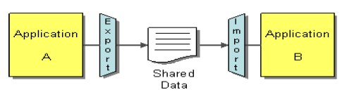
Integration Styles
File Transfer
- An application would share data by placing it in a file and providing it to the counterpart application
- Both parties will have to understand the format of the file
- The most popular format is JSON (JavaScript Object Notation), although XML (eXtensible Markup Language) is also still widely used.
Department of……………………………

Slide 19
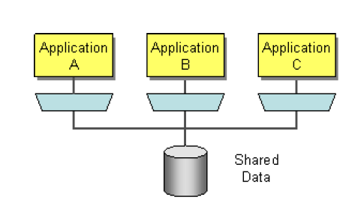
Integration Styles
Shared Database
- Shares data by all integrating applications (of varying technologies and platforms) using a common database
- All parties need to be aware of the persistence schema and coordinate changes to shared schemata
- Allows each application to function synchronously and supports both publishing and retrieval of data
Department of……………………………

Slide 20
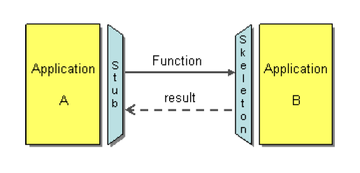
Integration Styles
Remote Procedure Invocation
- Connects applications by the „client‟ application (the consumer) invoking a function/passing a message to a „server‟ application (the provider) and waiting for a result message
- Benefit from using standard communication protocols (e.g. HTTP) to connect with each other and standard data formats (e.g. XML, JSON) to help represent the content being communicated
- Combinations of the above protocols and formats can be seen in SOAP Web Services and RESTful Web Services
Department of……………………………

Slide 21
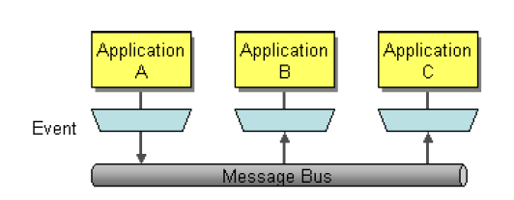
Integration Styles
Messaging
- Integrates applications through the passing of messages via a “message bus‟ - a common message transportation mechanism
- Messaging results in systems that are “loosely coupled‟ (which is a very desirable design trait), allowing each application to be modified in isolation
Department of……………………………

Slide 22
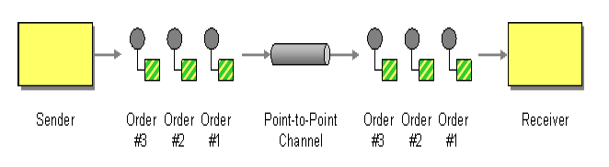
Enterprise Integration Patterns
A pattern is the re-usable form of a solution to a problem. A pattern language is an organized collection of patterns within a given field of study
Point-to-Point Channel
- Point-to-Point Channels are a mechanism for ensuring that exactly one receiver will receive a specific message.
- Point-to-Point channels are typically realized in Message Queuing systems, where a channel would be a queue, possibly with FIFO (First In, First Out) message delivery
Department of……………………………

Slide 23
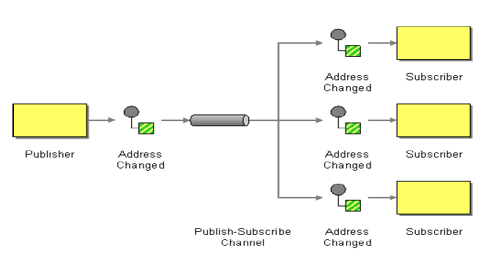
Enterprise Integration Patterns
Publish-Subscribe Channel
- Describes how multiple receivers will receive a specific message
- The sender is known as the publisher and the recipients (who subscribe to receive publications) are known as subscribers
- Publish-Subscribe channels are typically realized in messaging systems as topics, where a topic is bound to by subscribers and written to by publishers
Department of……………………………

Slide 24
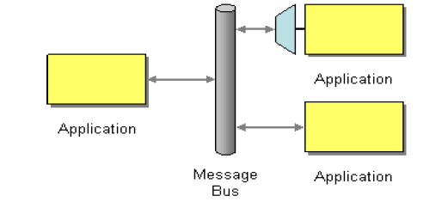
Enterprise Integration Patterns
Message Bus
- More advanced and used in response to an enterprise scenario where several systems need to be able to fulfill business requests, operating in a unified manner, with the facility to easily add or remove applications without affecting other applications.
- A bus, in computing terms, is a common communication mechanism between components of a system.
- A message bus combines a standardized payload format, a common set of operations and message delivery mechanisms to enable integration
Department of……………………………

Slide 25
Interacting with
Database
Department of……………………………

Slide 26
Understand MySQL
One of the most common applications of PHP is to provide a Web interface for accessing a database
Some of the more popular commercial DBMS packages are Oracle and Microsoft SQL Server, but there are also two prominent open-source DBMS packages, MySQL and PostgreSQL
Use MySQL in our study, since it is easily available and used quite frequently for Web pages in conjunction with PHP
Department of……………………………

Slide 27
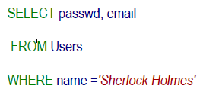
Simple SQL Retrieval
SELECT query :
Searching Fields
Table Name
Searching Condition
Department of……………………………

Slide 28
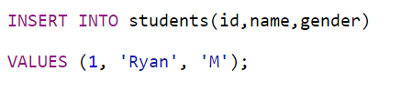
Simple SQL Retrieval
INSERT query :
Table Name
Table Fields
Table Data
Department of……………………………

Slide 29
Database Functions
$db = mysqli_connect(host, username, password, dbname) – Connects to the DBMS whose address is identified by the parameter
$result = mysql_query($sql, $db)– Sends a query to the DBMS. The SQL code should be located in the string passed as the first parameter; the second parameter should be a reference to the DBMS connection as returned by mysql_connect.
mysqli_error()– If the last executed query failed for some reason, mysqli_error returns a string that describes this error
mysqli_close()– function closes a previously opened database connection.
Department of……………………………

Slide 30

Thank you
PO Box 21, Nawala, Nugegoda, Sri Lanka
Phone: +94 11 288 100
www.ou.ac.lk

